Slide 1

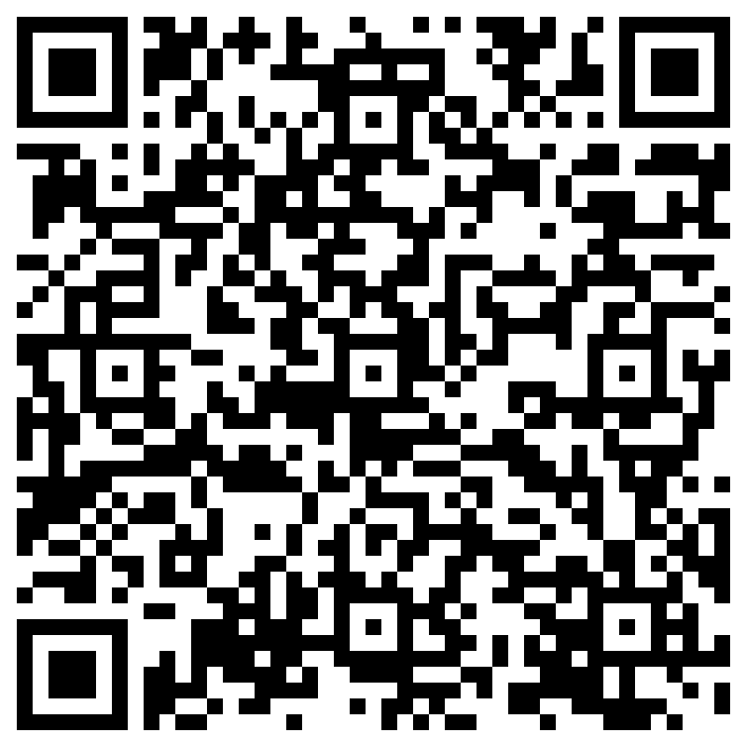


The speakeasy bitesize sessions support positive and accurate communication between families and children around all aspects of growing up.
These sessions will provide information to parents and carers on the online digital world, culture, adolescent brain development and risk.
Speakeasy Bitesize Sessions:
All sessions will take place at Perth Grammar School, 5.30pm – 7.30pm
Culture - Tues 15th April
Adolescent Brain Development – Wed 21st May
To apply for a place please scan QR code and fill out application form

